Slide 1



hollywood_movies
View in Power BI
Last data refresh:
12/03/2024 07:05:25 UTC
Downloaded at:
12/03/2024 07:08:52 UTC

Slide 2
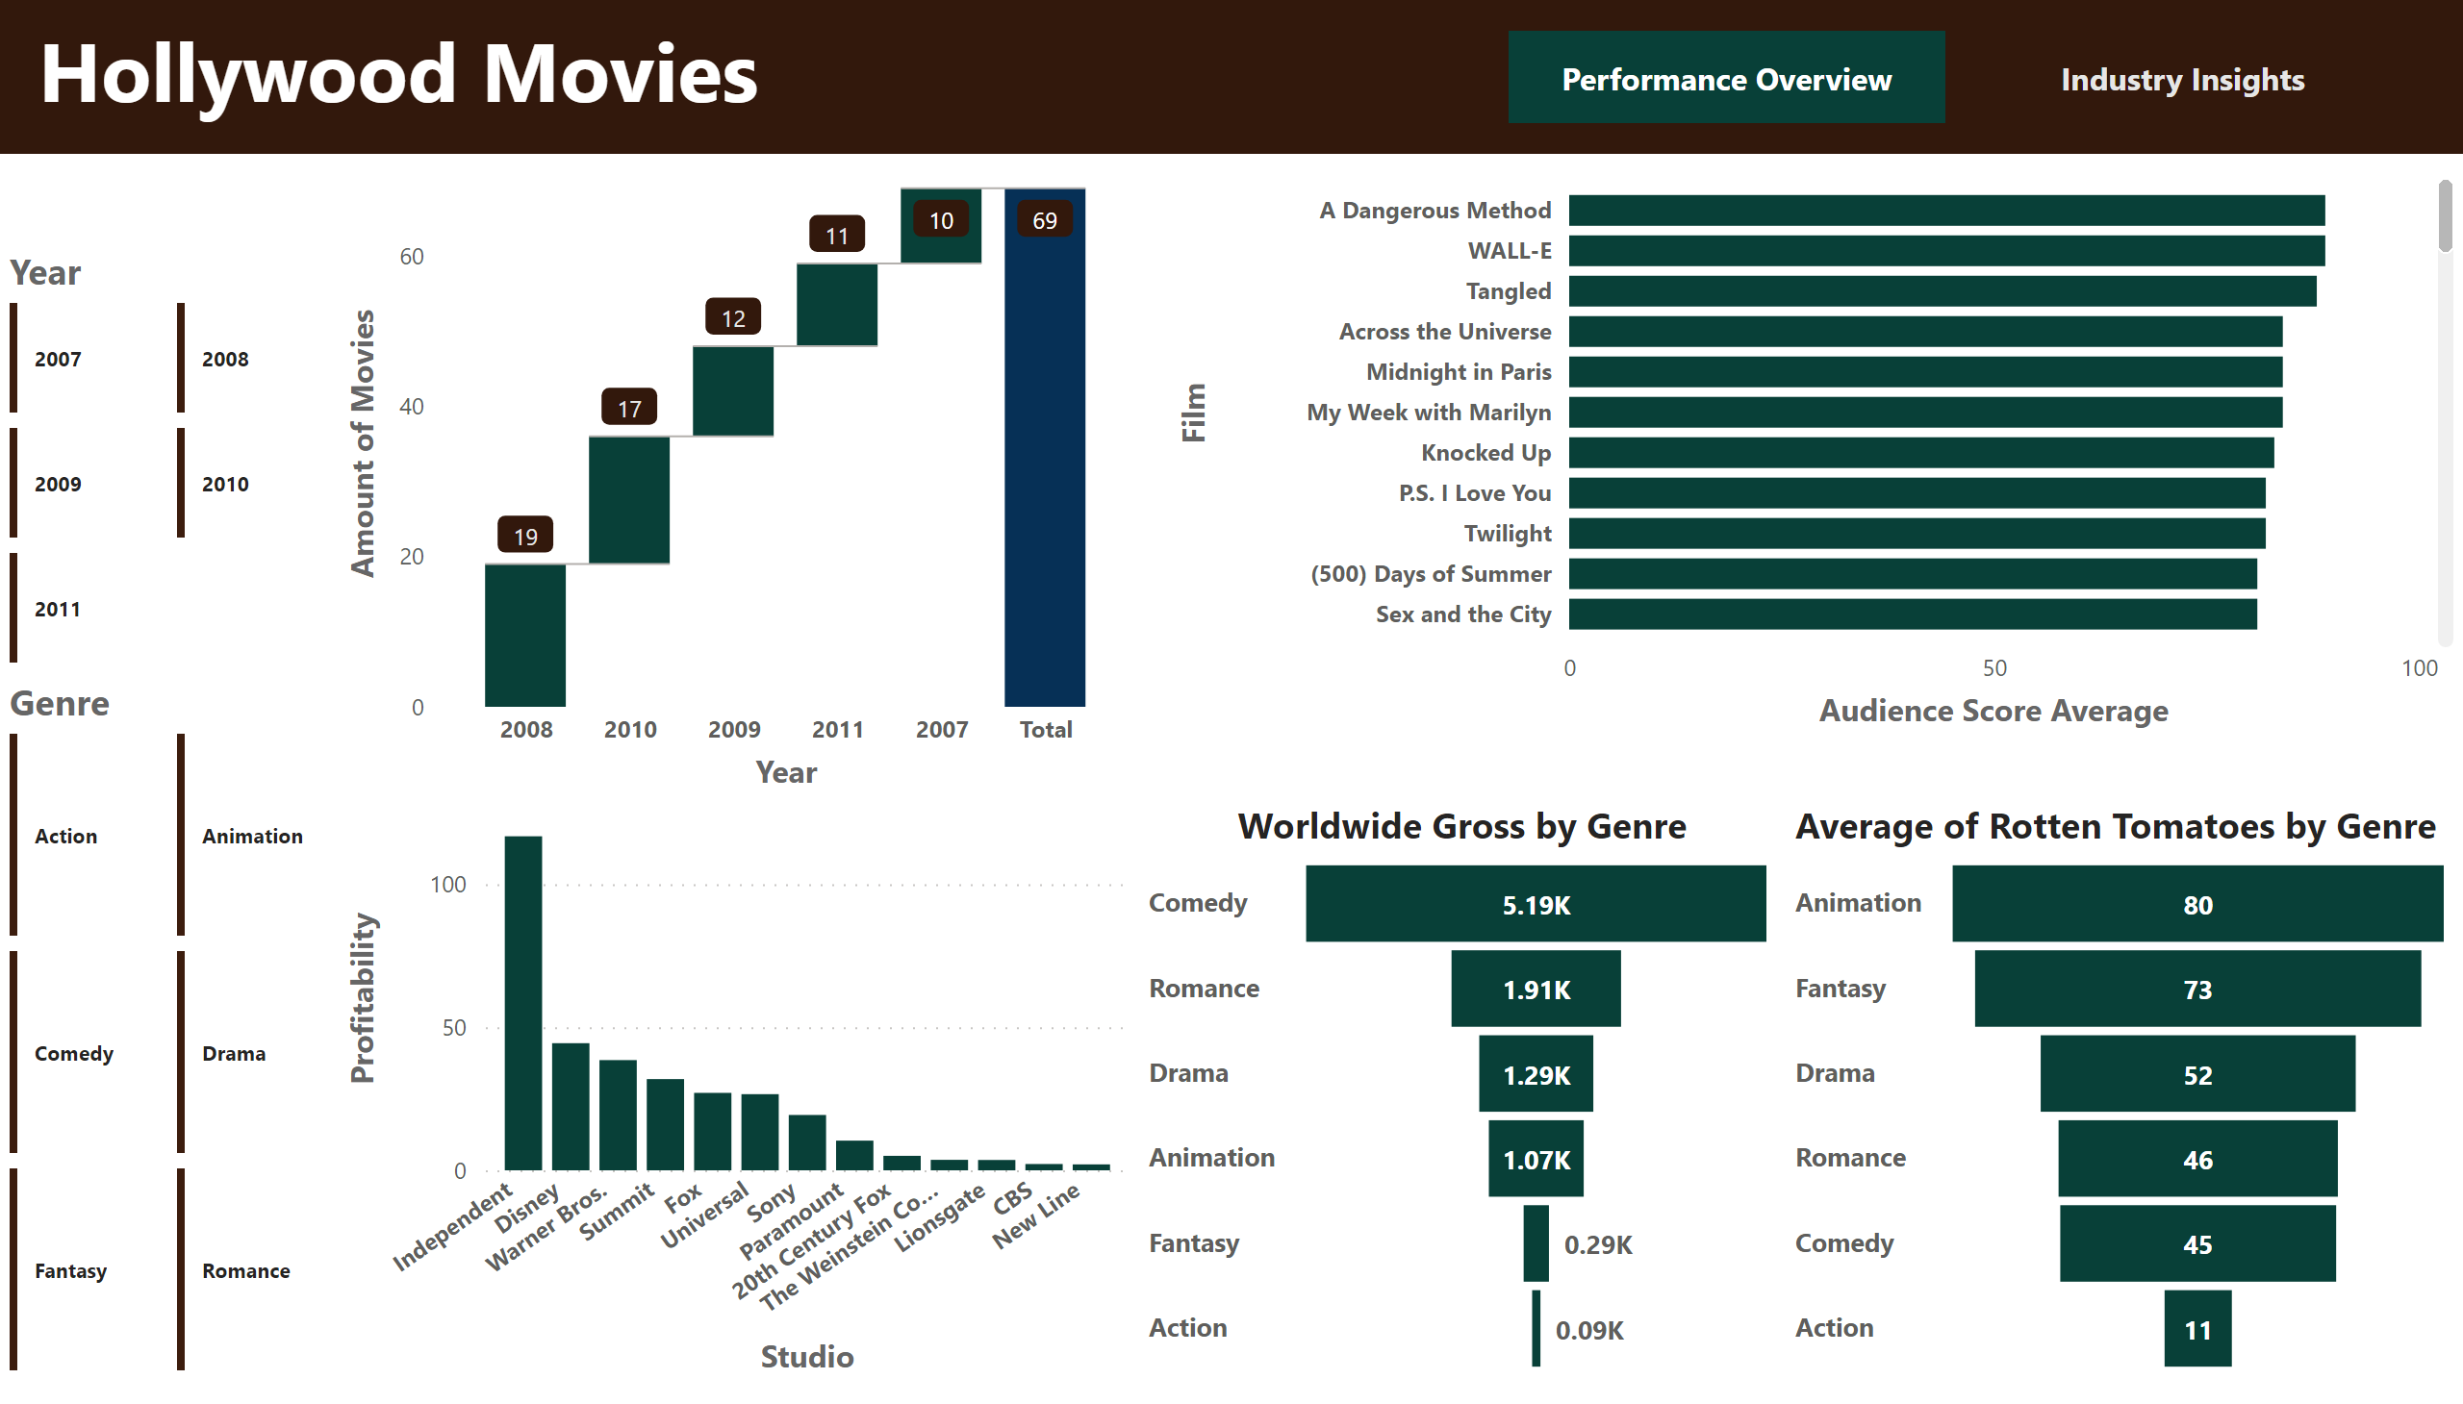
Performance Overview
Notes:
Average of Rotten Tomatoes by Genre
No alt text provided
waterfallChart
No alt text provided
clusteredBarChart
No alt text provided
lineStackedColumnComboChart
No alt text provided
Worldwide Gross by Genre
No alt text provided
textbox
No alt text provided
advancedSlicerVisual
No alt text provided
advancedSlicerVisual
No alt text provided
pageNavigator
No alt text provided

Slide 3
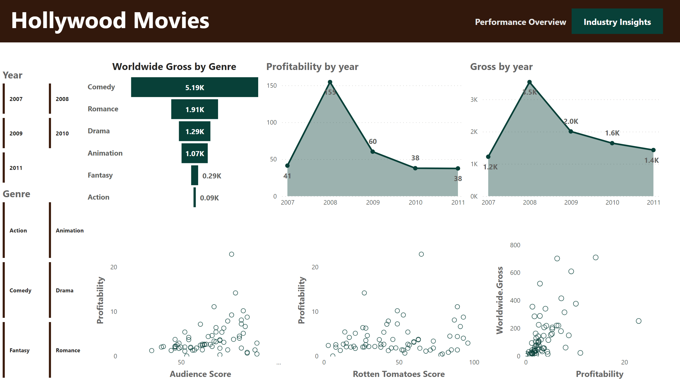
Industry Insights
Notes:
textbox
No alt text provided
pageNavigator
No alt text provided
advancedSlicerVisual
No alt text provided
advancedSlicerVisual
No alt text provided
scatterChart
No alt text provided
Gross by year
No alt text provided
Profitability by year
No alt text provided
Worldwide Gross by Genre
No alt text provided
scatterChart
No alt text provided
scatterChart
No alt text provided

